Slide 1

Fundamentals of Artificial Intelligence
Farian S. L Ishengoma

Slide 2
Course aim
This course aims at providing students with fundamental knowledge on intelligent and learning systems.
It will also cover approaches and methods for developing intelligent and learning system.

Slide 3
Expected Learning Outcomes
At the end of the course, students should be able to:
Understand key applications of Artificial Intelligence
Have knowledge of the fundamentals of Artificial Intelligence

Slide 4

Introduction to Artificial intelligence

Slide 5

Chapter one

Slide 6
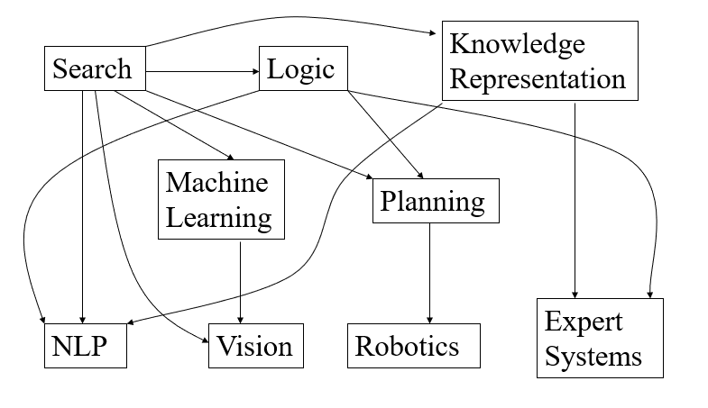
Definitions of AI and other key terms

Slide 7
Definitions of AI
AI is the study of ideas that enable computers to be intelligent.
AI is the part of computer science concerned with design of computer systems that exhibit/display human intelligence
AI, refers to the simulation of human intelligence in machines that are programmed to perform tasks that would typically require human intelligence to complete.

Slide 8
key terms used in AI
Machine learning:
A subset of AI that uses algorithms to identify patterns in data and learn from that data, without being explicitly programmed to do so.
Deep learning:
A type of machine learning that uses neural networks with many layers to learn and make predictions based on large datasets.
Natural language processing (NLP):
The ability of machines to understand and process human language.
Computer vision:
The ability of machines to interpret and understand visual data from the world around them.

Slide 9
Cont.
Robotics:
The use of machines that can sense, reason, and act to perform physical tasks in the physical world.
Neural networks:
A type of machine learning algorithm that is designed to mimic the structure and function of the human brain.
Expert systems:
AI systems that are programmed to make decisions based on a set of rules and knowledge about a particular subject or domain.
Reinforcement learning:
A type of machine learning in which an agent learns to make decisions by receiving feedback in the form of rewards or penalties based on its actions.

Slide 10
Homework
Write a concise history of AI. You must include references. The document should not exceed two pages in length.

Slide 11
AI MODELS
Semiotic models
Based on sign processes or signification and communication
Statistical models
Based on statistical techniques
Various AI models are based on statistical
These models convey signs or sign systems in relation to the problem.

Slide 12
AI MODELS
Convolutional Neural Networks (CNNs):
Used primarily for image and video recognition, CNNs are a type of deep learning model that can learn to identify patterns in images and videos. Ex Inception, Resnet
Recurrent Neural Networks (RNNs):
Used for natural language processing and speech recognition, RNNs are a type of deep learning model that can analyze sequences of data, such as sentences or speech. Ex, LSTM
Generative Adversarial Networks (GANs):
Used for generating new data, such as images or music, GANs are a type of deep learning model that can learn to create new data by learning from existing data. Ex Stylle GAN

Slide 13
Cont.
Decision Trees:
Used for classification and regression tasks, decision trees are a type of machine learning model that can analyze data and make decisions based on a set of rules. Ex Random forest and XGboost
Support Vector Machines (SVMs):
Used for classification and regression tasks, SVMs are a type of machine learning model that can analyze data and create a boundary that separates different classes or groups. Ex C-SVM and Nu-SVM
Naive Bayes:
Used for classification tasks, Naive Bayes is a simple machine learning model that can analyze data and make predictions based on the probability of different outcomes.

Slide 14
Cont.
K-Means Clustering:
Used for unsupervised learning tasks, such as grouping similar data points together. Examples include K-Means and Hierarchical Clustering.
Transformer-based Models:
Used for natural language processing tasks, such as language translation and text summarization. Examples include BERT, GPT, and T5.

Slide 15

Chapter two

Slide 16
intelligent agents and rationality
Intelligent agents
are entities that can perceive their environment, reason about it, and take actions to achieve a goal.
In machine learning, agents are typically implemented using algorithms that learn from experience to improve their decision-making abilities.
Rationality
is an important concept in the context of intelligent agents, as it refers to the ability of an agent to make decisions that lead to the best possible outcome, given its knowledge and resources.
An agent is said to be rational if its actions are consistent with its goals and maximize its expected utility.

Slide 17
examples of intelligent agents and their rationality in machine learning
Autonomous vehicles:
are a good example of intelligent agents that use machine learning to navigate roads and make decisions about how to drive safely.
These agents must be rational in their decision-making, considering factors such as traffic patterns, weather conditions, and the behavior of other drivers.
Personal assistants:
are intelligent agents that use natural language processing and machine learning to understand and respond to user queries. Example Google Assistant
These agents must be rational in their responses, providing the most accurate and useful information possible.

Slide 18
Cont.
Trading bots:
are intelligent agents that use machine learning to analyze market data and make decisions about buying and selling financial assets.
These agents must be rational in their decision-making, taking into account factors such as market trends, news events, and historical data.
Recommender systems:
are intelligent agents that use machine learning to suggest products, services, or content to users.
These agents must be rational in their recommendations, taking into account factors such as user preferences, historical behavior, and contextual information.

Slide 19
Agents in ML
Program
is specifically designed to operate autonomously in an environment and make decisions that will maximize some notion of reward or utility
Can learn from its experiences and adapt its behavior to better achieve its goals over time.
are often designed to operate autonomously, meaning that they can make decisions and take actions without human intervention.
is designed to perform a fixed set of tasks and does not have the ability to learn from its experiences or adapt on its own
Can be designed to perform a wide range of tasks(set of instructions) that tells a computer what to do, such as performing calculations, manipulating data, or interacting with users
Are typically designed to be run by a user and may require human input to perform their tasks.

Slide 20
Connection of agent and environment
Environment
Sensors
Percept (Observations)
Environment
Agent Function
Agent
Actuator
Action

Slide 21
Environment tasks (PEAS)
Performance Measure:
captures agent’s aspiration
Environment:
context, restrictions
Actuators:
indicates what the agent can carry out
Sensors:
indicates what the agent can perceive

Slide 22
PROPERTIES OF ENVIRONMENT
Fully observable against partially observable
Deterministic against stochastic
Episodic against sequential
Static against dynamic
Discrete against continuous
Single agent against multiagent

Slide 23
TYPES OF AGENT
Reflex Agent
Reflex Agent with State
Goal-based Agent
Utility-Based Agent
Learning Agent

Slide 24
REFLEX AGENT
A reflex agent is responds to its environment based on a set of pre-defined rules or conditions.
It operates by mapping its current perceptual input directly to an action without any internal representation of the environment.
A reflex agent works based on a set of predefined rules or conditions, also known as the agent's knowledge base, which allows it to take immediate action based on its current perception.
The knowledge base is typically represented in the form of an if-then statement, which maps a given percept to a corresponding action.
They are not capable of handling situations where the environment is dynamic or uncertain.
Also, they cannot plan and anticipate future states of the environment.
For example, consider a reflex agent designed to operate in an environment with traffic lights. The agent's knowledge base might contain the following rule: "If the traffic light is red, stop; if it is green, go; if it is yellow, proceed with caution." The agent would use this rule to take immediate action based on its current perceptual input, which in this case would be the color of the traffic light.

Slide 25

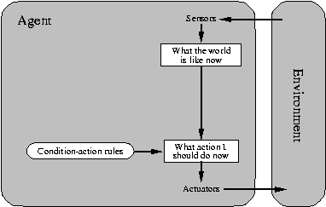

REFLEX AGENT

Slide 26
Reflex Agent with State
A reflex agent with state responds to its environment based on a set of pre-defined rules or conditions, considering the current state of the environment.
Itmaintains an internal representation of the environment, which allows it to consider the history of its previous actions and observations when deciding what action to take next.
The state of the environment is represented by a set of variables that capture relevant aspects of the environment, such as the position of objects, the state of devices, or the values of sensory inputs.
The agent's knowledge base is updated based on its current state and its previous actions and observations, allowing it to make more informed decisions.
Reflex agent, still has some limitations, such as the inability to plan ahead or anticipate future states of the environment.
For example, consider a reflex agent designed to operate in a maze environment. The agent's state would include variables such as its current position in the maze, the positions of obstacles, and the location of the goal. The agent's knowledge base might contain rules such as "If there is an obstacle in front of me, turn left; if I am at the goal, stop." The agent would use this rule to take immediate action based on its current state, which in this case would include its current position in the maze.

Slide 27
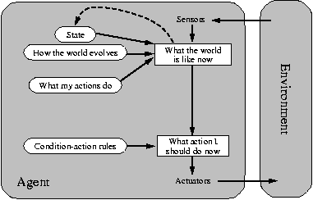
Reflex Agent with State

Slide 28
Goal-based Agent
A goal-based agent is designed to achieve a specific goal or set of goals.
It takes a more proactive approach by planning and executing actions that lead to the desired outcome.
It operates by maintaining a representation of its goals and the current state of the environment, and then uses this information to plan a sequence of actions that will achieve its goals.
The agent's knowledge base consists of a set of rules that describe how to achieve the goals given the current state of the environment.
It can handle complex environments and achieve complex goals by breaking them down into smaller sub-goals and planning a sequence of actions to achieve each sub-goal.
They can also handle dynamic and uncertain environments by continuously monitoring the environment and adapting their plans accordingly.
They can be used in a variety of applications, including robotics, autonomous vehicles, and game playing.
An example of a goal-based agent in machine learning could be a virtual assistant such as Apple's Siri or Amazon's Alexa. These agents are designed to help users accomplish specific tasks, such as finding information, setting reminders, or playing music. To do this, the agent needs to understand the user's goals and act accordingly.

Slide 29
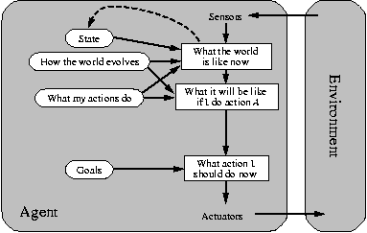
Goal-based Agent

Slide 30
Utility-based Agent
A utility-based agent is designed to make decisions based on a utility function or measure of how desirable the outcome is.
The agent's goal is to maximize its expected utility, which considers both the likelihood of achieving the goal and the desirability of the outcome.
A utility-based agent operates by maintaining a representation of its goals and the current state of the environment, and then uses this information to determine the expected utility of each possible action.
The agent's knowledge base consists of a set of rules that describe how to compute the expected utility of each action given the current state of the environment.
Utility-based agents can handle complex environments and achieve complex goals by considering both the likelihood of achieving the goal and the desirability of the outcome.
They can also handle dynamic and uncertain environments by continuously monitoring the environment and updating their expected utilities accordingly.
They can be used in a variety of applications, including robotics, autonomous vehicles, and game playing, and are particularly useful in situations where the outcome is uncertain, or the goals are complex.
An example of a utility-based agent in machine learning could be a self-driving car. The car's decision-making process is based on the utility of its possible actions. For example, if the car encounters a pedestrian crossing the road, it needs to decide whether to stop or swerve to avoid hitting the pedestrian..

Slide 31
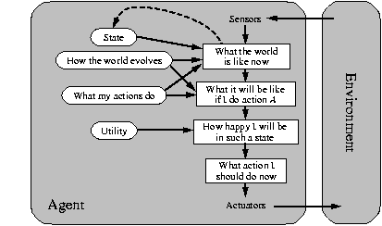
Utility-based Agent

Slide 32
Learning Agent
A learning agent is designed to learn from its environment and improve its performance over time.
Learning agents are particularly useful in situations where the environment is complex and dynamic, and it is difficult or impossible to pre-program all possible scenarios.
A learning agent operates by receiving inputs from the environment and using these inputs to update its knowledge or model of the environment.
The agent's knowledge base consists of a set of rules or algorithms that allow it to process and respond to the environment.
The agent's performance is evaluated based on a reward or reinforcement signal, which indicates how well it is performing in achieving its goals.
There are several types of learning agents, including supervised learning agents, unsupervised learning agents, and reinforcement learning agents.
Learning agents can be used in a variety of applications, including robotics, autonomous vehicles, and game playing.
They can also be used to analyze and make predictions about complex data sets in fields such as finance, healthcare, and social media.

Slide 33
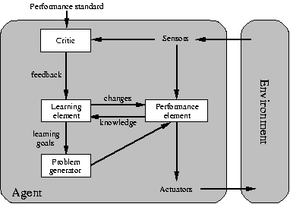
Learning Agent

Slide 34
The concept rationality
Rationality refers to the ability of an algorithm to make decisions based on comprehensive reasoning and evidence.
This involves using mathematical models and statistical methods to analyze data and arrive at the best possible solution to a given problem.
Example:
consider a machine learning algorithm that is designed to recognize handwritten digits.
A rational approach to this problem would involve training the algorithm on a large dataset of labeled images of digits, and using a statistical model to learn patterns in the data that correspond to different digits.
The algorithm would then be able to recognize new handwritten digits with a high degree of accuracy.
consider a person who is trying to decide whether to invest in a particular stock.
A rational approach to this decision would involve researching the company, analyzing its financial performance, and considering the current state of the stock market.
Based on this information, the person would then weigh the potential risks and rewards of investing in the stock and make a decision accordingly.

Slide 35
End

